Slide 1
Solid State Drive

Slide 2
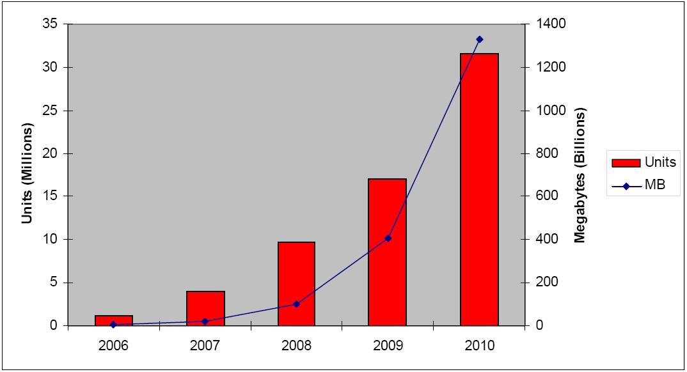

Slide 3
Advantages
Reliability in portable environments and no noise
  No moving parts
Faster start up
  Does not need spin up
Extremely low read latency
  No seek time (25 us per page/4KB)
Deterministic read performance
  The performance does not depends on the location of data

Slide 4
Disadvantage
Cost significantly more per unit capacity
  3$/GB vs. 0.15$/GB
Limited write erase time
  100000 writes for SLC (MLC is even fewer)
  high endurance cells may have an 1-5 million
  But some files still need more
  Weaver leaving to spread writes all over the disk
Slower write speeds because of the erase blocks are becoming larger and larger(1.5 ms per erase)
For low capacity flash SSDs, low power consumption and heat production when in active use. High capacity SSDs may have significant higher power requirements

Slide 5
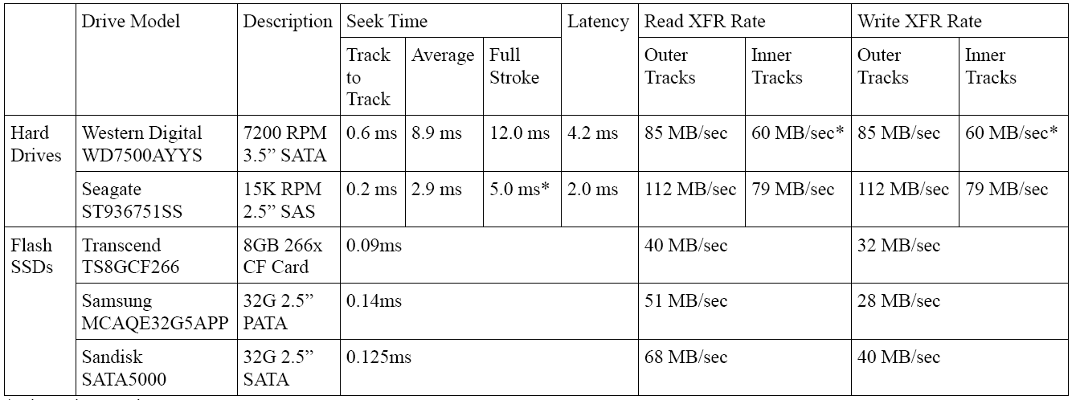
Typical read and write rates

Slide 6
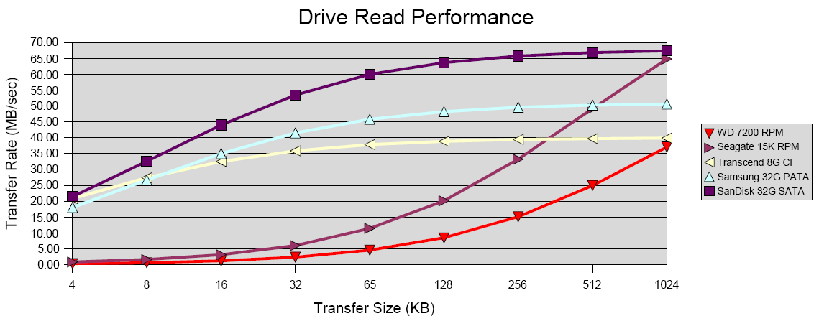
Drive read performance

Slide 7
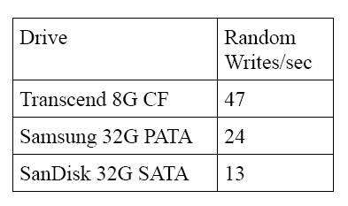
Drive write performance

Slide 8
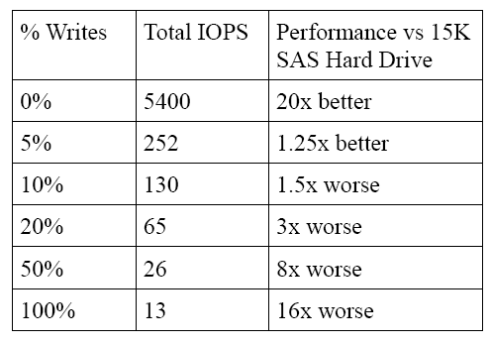
Mixed writes and reads

Slide 9
Improve write performance
OS write caching
Flash specific file system
Drive Write Caching
Multiple concurrent erase blocks
  Expensive: 200~400$ /GB

Slide 10
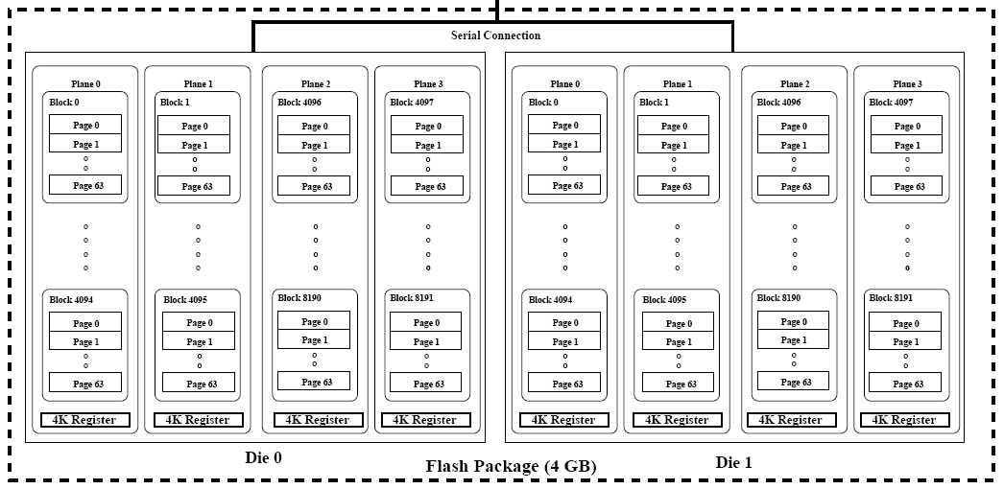
Samsug flash internals

Slide 11
Bandwidth and interleave
Without interleaving
  For read: 25+100 us per page
    8000 reads/s = 32MB/s
  For write: 200+100 us per page
    3330 writes/s = 13 MB/s
With interleaving
  For read
    10000 reads/s = 40MB/s
  For write
    5000 writes/s = 20 MB/s

Slide 12
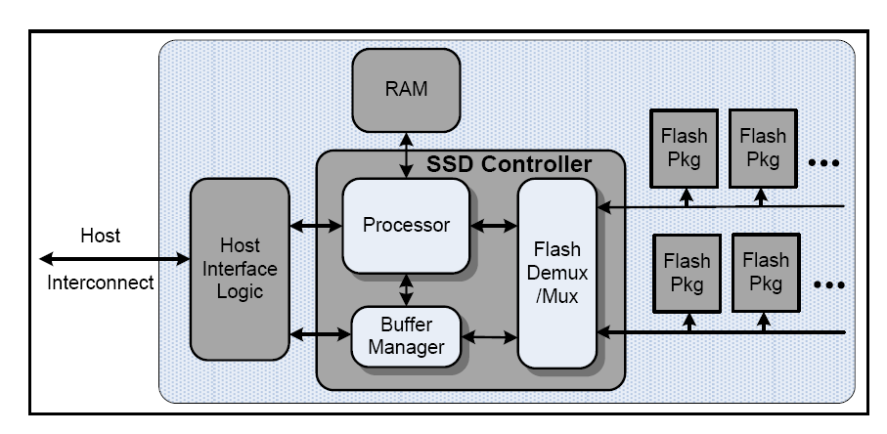
SSD Logic components

Slide 13
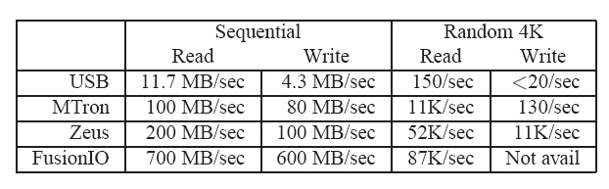

Slide 14
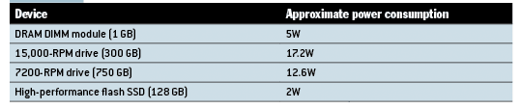
Power consumption

Slide 15
An example of SSD
1 die = 4 planes
1 plane = 2048 blocks
1 block = 64 pages
1 page = 4KB
Dies can operate independently
Reading and programming is performed on a page basis, erasure can only be performed on a block basis.

Slide 16
Read
  25μs from page to data register
  100μs transfer in the serial line
Write
  Page granularity
  Sequentially with in a block
  Block must be erased before writing
  200μs from register into flash cells

Slide 17
Block erasure:
  The erase state: 0xFF or 0x00
  1.5ms ( 25μs for reading a page)
  Finite number of erase-write cycles
Cleaning:
  Erase out-of-date pages
  Garbage collecting

Slide 18
Flash File System:
  ZFS, has be optimized
  JFFS2

